Slide 1
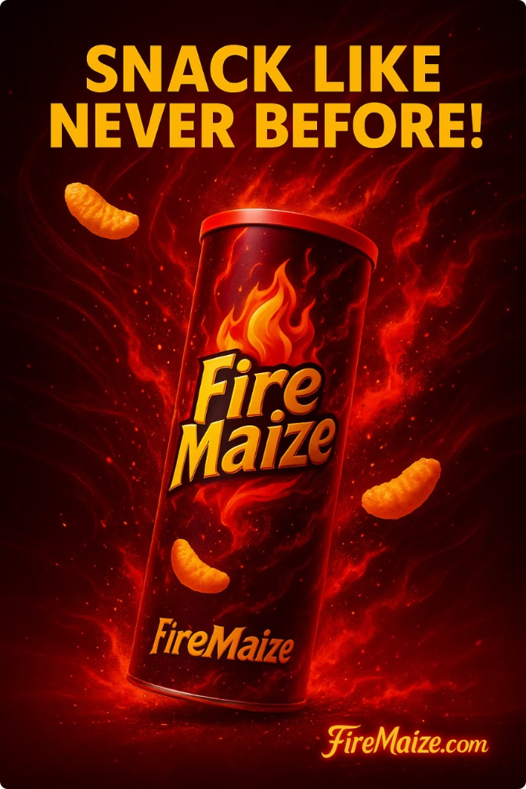

Fire Maize: SNACK LIKE NEVER BEFORE!
FireMaize Creative Studio presents our campaign for hot Peri-Peri Potato Chips. We're igniting brands with bold ideas across urban Pakistan.
et

Slide 2
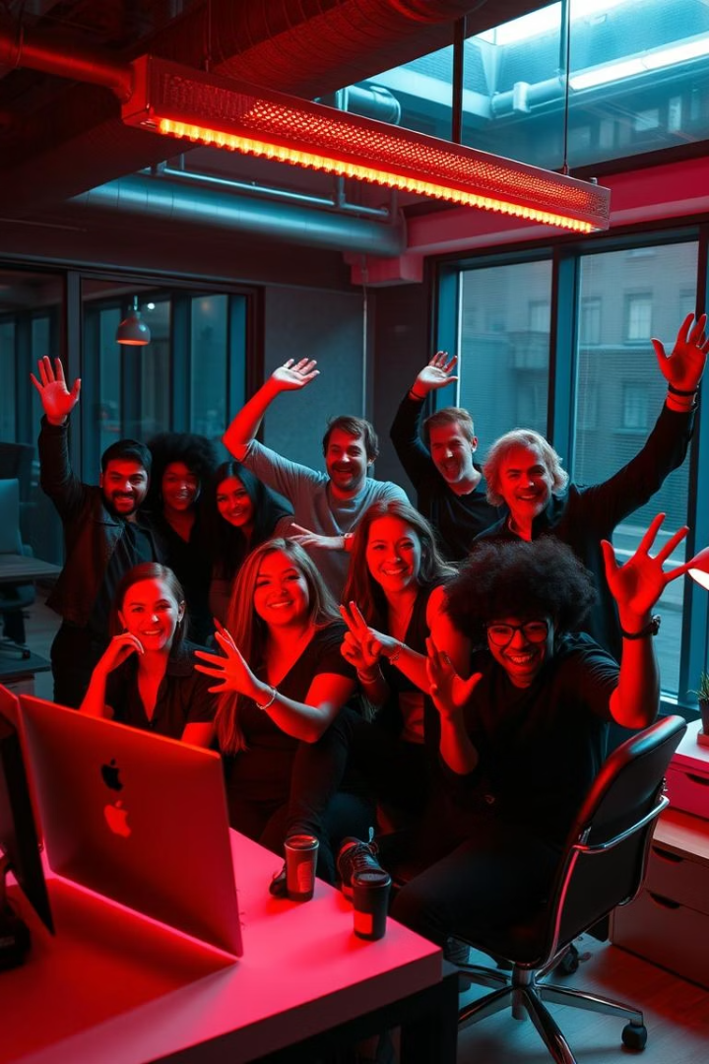





Meet The Team
Azaan Nabi
Aahil Ashiq
Khuzaima Ahsan
Bilal Ali
Ehaab Tariq

Slide 3
Our Client & Product
FireMaize
Launch Market
Hot Peri-Peri Potato Chips with intense flavor, bold crunch, and fiery attitude.
Urban Pakistan - specifically Karachi and Lahore.

Slide 4






Campaign Objective & Target Market
Primary Objective
Grow awareness by 50% & boost sales 20% by August 2025
Primary Market (18-34)
Spice lovers, social media natives, thrill seekers
Secondary Market (35-50)
Food lovers, family snackers, weekend entertainers

Slide 5
Executional Framework
Message Strategy
Transformative appeal centered on excitement and boldness
Creative Strategy
Sensory overload with fiery visuals and an energetic sound
Media Strategy
Integrated across print, digital (Instagram), radio, and video for max reach and entertainment

Slide 6

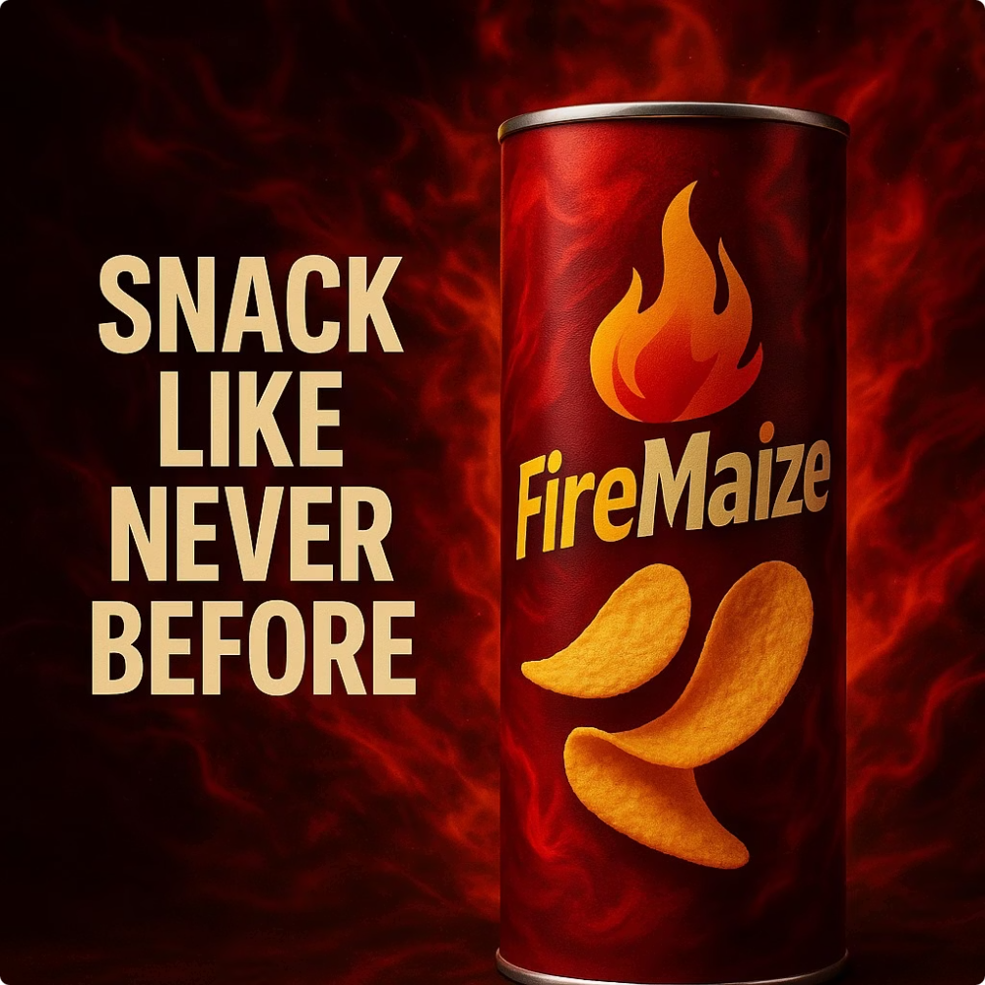
Print Ad Strategy
Title
Visuals
"Feel the Fire. Taste the Crunch."
Urban backdrop, young people sharing chips, bright flames, QR code
Strategic Choice
Instagram Influencer promotions, can reach about 2 million+ Pakistanis through social media.

Slide 7
Type of Appeal
Sensory Appeal
Emotional Appeal
Heat, Spice, Fire, a craving for cold water after eating
Social fun, dares between teenagers, challenges to see who can handle the spice better.
Lifestyle Appeal
Urban, adventurous and trend-conscious snacks.

Slide 8
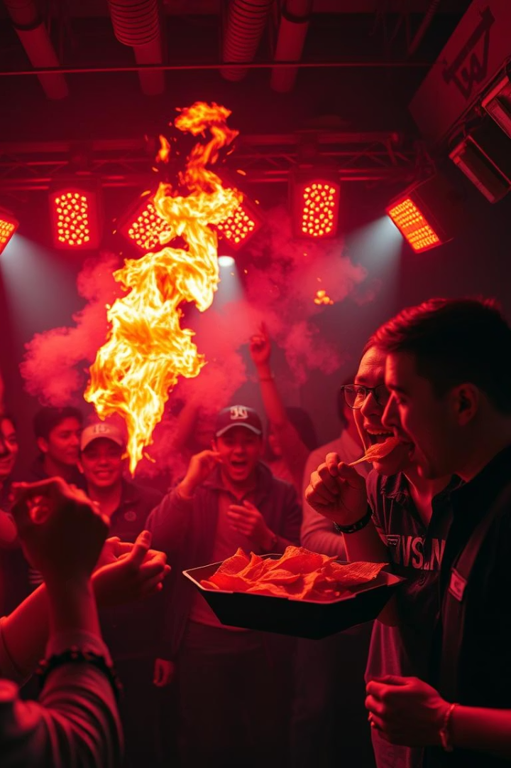



Video Campaign
12-Second Video
"Snack Bold. Snack FireMaize."
Visual Hook
Rapid cuts, flames whooshing, energetic music
Why Video?
Energizes, immerses, boosts emotional engagement

Slide 9
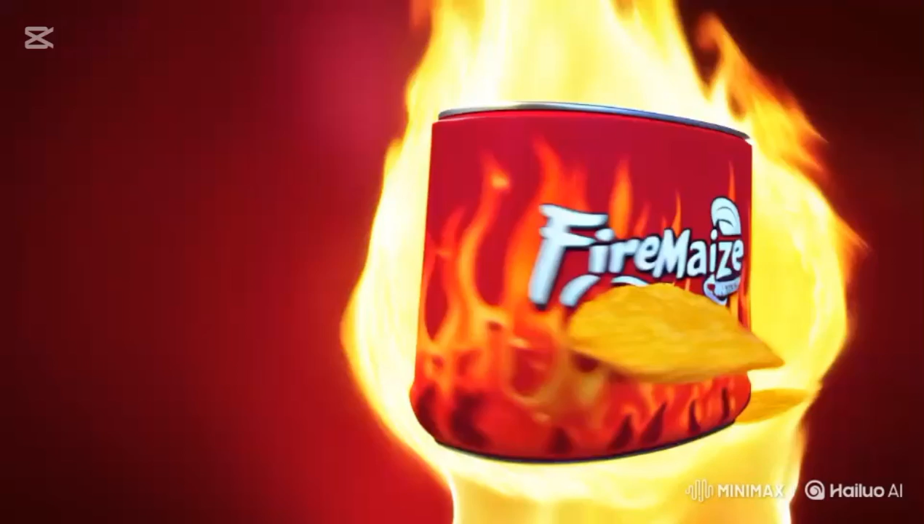
Video Ad

Slide 10









Social & Radio Strategy
Instagram
Radio
Visual platform for 18-34s with Reels, Story polls, #FireMaizeVibe challenge
"Fire in Every Bite" - high-energy sizzle and crunch sounds
Objective
Stations
Create audio craving and brand association through repetition
FM 91, City FM89, FM 100 during peak hours

Slide 11
Social & Radio Budget
Instagram
Radio
Possible Food Influencers:
Hamza Bhatti (@hamzathebhatti)
440K Followers on Insta: 70K per post
Mahnoor Saad (@thefoodiefreakfromislamabad)
510K Followers on Insta: 90K per post
Estimated cost for 20 second radio ad:
FM 91: 15,000 PKR
City FM89: 18,000 PKR
FM100: 12,000 PKR

Slide 12

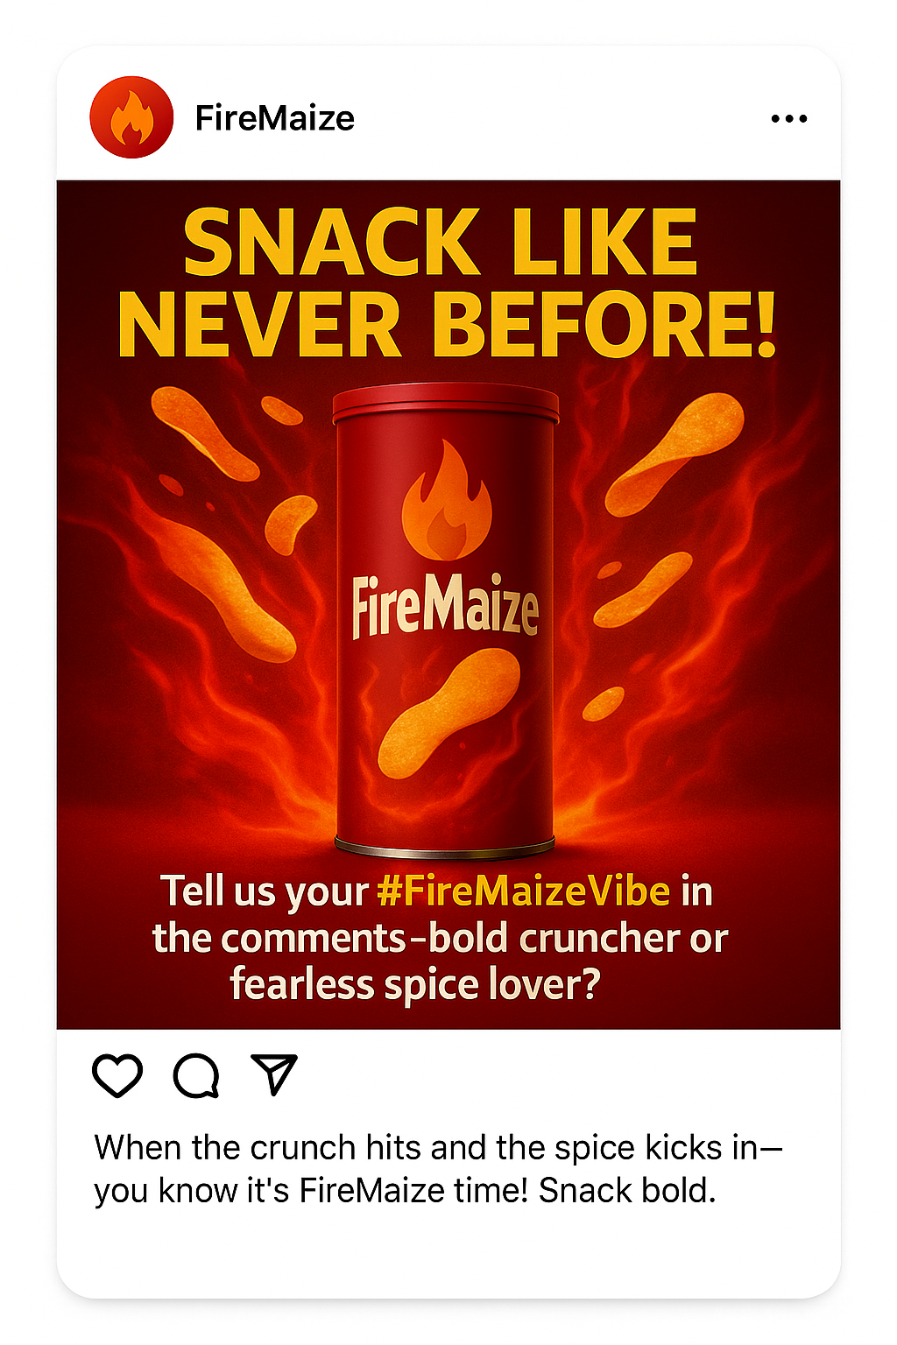
Social Media: Instagram Campaign Post

Slide 13
Product Positioning Approaches
Use/Application Approach
Positioning the snack as the ideal snack for social gatherings.
Product User Approach
Associate FireMaize with young, adventurous teenagers who seek boldness.
Attribute-based Positioning
Emphasize the chips unique attributes, like the Peri Peri flavor and satisfying crunch.

Slide 14
Communications Schedule: Pulsating
The primary audience (18–34-year-old urban dwellers) is highly active on social media platforms. A pulsing schedule enables continuous interaction, with intensified campaigns during periods of heightened online activity.
FireMaize is a snack that appeals to consumers throughout the year, with potential sales surges during specific events like festivals or holidays.
By maintaining a baseline advertising presence and intensifying efforts strategically, pulsing ensures optimal use of the advertising budget, focusing resources when they are most impactful.

Slide 15



Let's Ignite A Spicy Movement
Create Awareness
Introduce FireMaize to urban Pakistan
Build Engagement
Drive participation in #FireMaizeVibe
Boost Sales
Convert buzz to 20% sales growth

